Slide 1
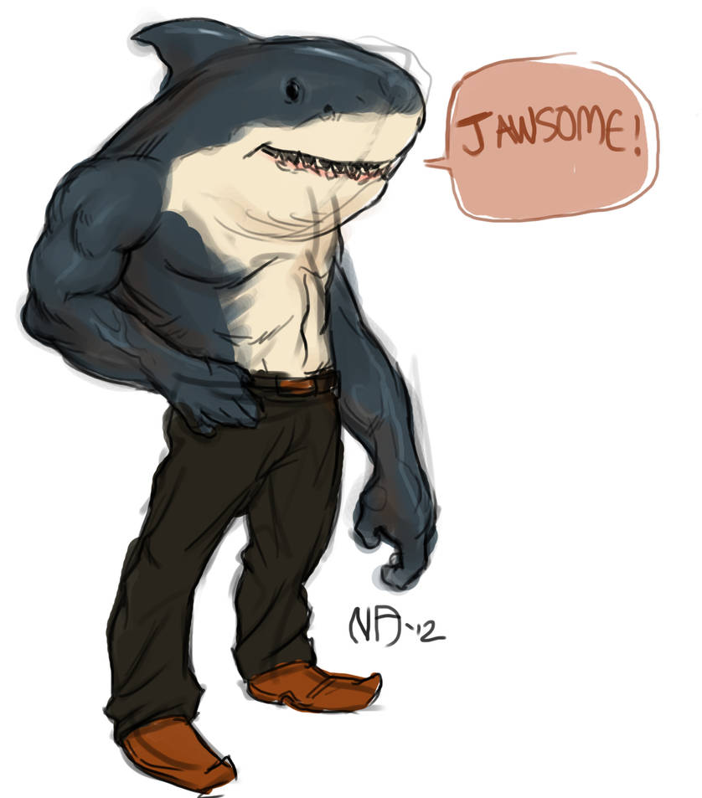
ESTUDIO SOBRE ATAQUES DE TIBURONES en el mundo
Mario Mérida
Ana Carramolino

Slide 2
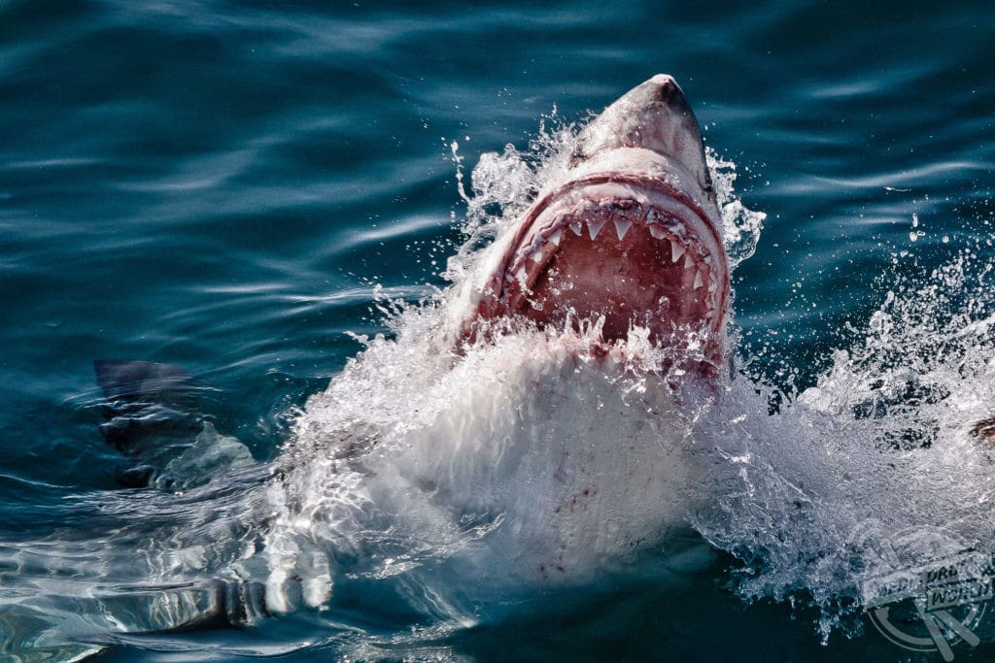
ÍNDICE DE CONTENIDOS
Introducción (ETL)
Análisis
Conclusiones:
Países con más ataques.
Actividades más peligrosas
Estacionalidad de los ataques
Edades más afectadas

Slide 3
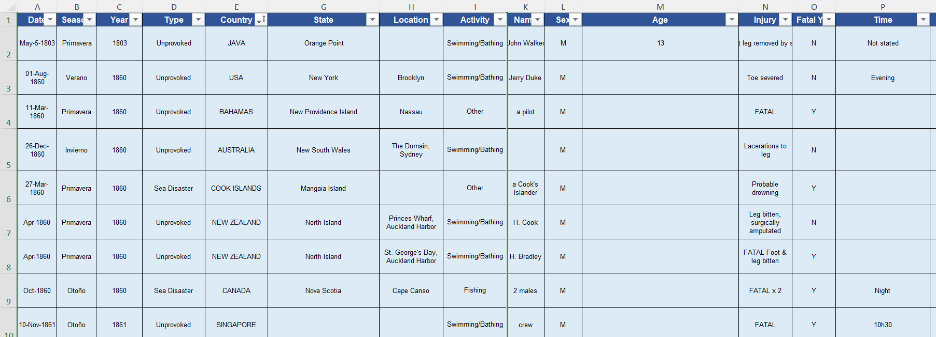
Introducción – ETL (Extract, transform, load)

Slide 4
ANÁLISIS DE DATOS
Count of Case Number
Country | Country | Total
USA |  | 2473
AUSTRALIA |  | 1452
Group1 |  | 1330
SOUTH AFRICA |  | 593
NEW ZEALAND |  | 143
PAPUA NEW GUINEA |  | 136
BAHAMAS |  | 129
BRAZIL |  | 119
MEXICO |  | 98
ITALY |  | 72
FIJI |  | 69
PHILIPPINES |  | 62
NEW CALEDONIA |  | 62
REUNION |  | 60
Grand Total |  | 6798

Slide 5
ANÁLISIS DE DATOS
Activity | Total
Diving | 525
Fishing | 1256
Other | 1773
Snorkeling | 121
Surfing | 1509
Swimming/Bathing | 1614
Grand Total | 6798

Slide 6
ANÁLISIS DE DATOS
Range | Total
0–9 | 153
10–19 | 1241
20–29 | 1122
30–39 | 640
40–49 | 428
50–59 | 267
60–69 | 123
70–79 | 33
80+ | 6
Unknown | 3032

Slide 7
ANÁLISIS DE DATOS
Season | Total
Invierno | 1471
Otoño | 1558
Primavera | 1397
Sin identificar | 619
Verano | 2000
Grand Total | 7045

Slide 8
ANÁLISIS DE DATOS
Country2 | Diving | Fishing | Other | Snorkeling | Surfing | Swimming/Bathing | Grand Total
USA | 126 | 320 | 521 | 38 | 874 | 594 | 2473
BAHAMAS | 19 | 55 | 28 | 13 | 3 | 11 | 129
AUSTRALIA | 156 | 286 | 350 | 28 | 312 | 320 | 1452
NEW ZEALAND | 6 | 38 | 32 | 3 | 23 | 41 | 143
SOUTH AFRICA | 27 | 137 | 145 | 3 | 153 | 128 | 593
BRAZIL | 2 | 9 | 26 |  | 41 | 41 | 119
FIJI | 13 | 22 | 21 | 1 | 2 | 10 | 69
NEW CALEDONIA | 3 | 24 | 12 | 3 | 11 | 9 | 62
MEXICO | 15 | 13 | 16 | 2 | 10 | 42 | 98
REUNION | 3 | 8 | 20 |  | 22 | 7 | 60
PHILIPPINES |  | 7 | 35 |  | 2 | 18 | 62
ITALY | 9 | 26 | 22 | 1 | 3 | 11 | 72
PAPUA NEW GUINEA | 11 | 56 | 44 |  | 1 | 24 | 136
ROW | 135 | 255 | 501 | 29 | 52 | 358 | 1330
Grand Total | 525 | 1256 | 1773 | 121 | 1509 | 1614 | 6798

Slide 9
CONCLUSIONES

Slide 10
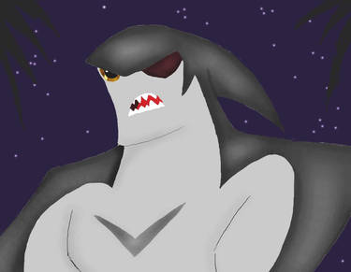
Gracias por vuestra atención

